Slide 1
PART 1 · PROJECT VISION
Swiggy Instamart AI Product Discovery Engine
WHY NOW? (Strategic Context)
Instamart already owns high-frequency grocery behavior. Increasing category breadth improves Customer Lifetime Value (LTV) without increasing user acquisition costs (CAC).
PORTFOLIO CASE STUDY LINKS
This portfolio project details a category penetration growth strategy and showcases a deployed quick-commerce checkout sandbox.
Please click the active links below to test the prototypes:
• Deployed Sandbox: Click link below
• Analytics Dashboard: Click link below
THE SCALE OF OPPORTUNITY
• Target Segment: ~35M Monthly Active Customers
• Repeat Loop: 75% order identical items every month
• Fee Impact: 64% reject checkout recommendations due to fees
• Projected AOV Lift: +18% average basket growth
MVP Sandbox URL: https://aashritamalviya1999.github.io/swiggy-instamart-discovery/
Analytics Dashboard URL: https://swiggy-instamart-discovery-6ss2oangvc44qmggkbvrhs.streamlit.app
Swiggy Instamart Growth Portfolio | AI Product Discovery Engine
Slide 1 of 10

Slide 2
PART 2 · PROBLEM FRAMING
Why Home Banners Fail vs. AI Ingestion Solutions
WHY AN AI-NATIVE SOLUTION?
• Traditional Dashboards vs. AI: - Traditional: ❌ Tells us WHAT people bought (repeat dairy/bread). - AI Discovery: ✅ Explains WHY users don't buy new categories.
• Real Evidence (Customer Review): ⭐⭐⭐⭐ "I just order milk every week. Never noticed the personal care section." -> Theme: Habit Loop -> Insight: Discovery isn't happening.
• Homepage Avoidance: Cluttered carousels create cognitive load, pushing users directly to reorder lists.
OUR AI-POWERED INGESTION LOOP
• Ingestion Flow: 1,000 Multi-Channel Reviews -> AI identifies themes -> AI validates evidence -> User Interviews -> Prioritized Opportunity -> MVP
• Actionable Synthesis: Scrapes Play Store, iTunes RSS, Reddit, and Twitter. Resolves mixed regional slang (e.g. bekar service -> service failure) and segments findings.
• Target Opportunity: Solves delivery fee friction on auxiliary purchases to boost category testing.
Swiggy Instamart Growth Portfolio | AI Product Discovery Engine
Slide 2 of 10

Slide 3
PART 2 · AI INGESTION WORKFLOW
The Sequential 7-Agent Ingestion Pipeline
THE AI PIPELINE WORKFLOW (Mandatory Outline)
• Data Ingestion: Scrapes reviews from Play Store, App Store, Reddit, and Twitter.
• Normalization & Cleaning: Removes duplicates, filters promo spam, and translates regional Hinglish slang.
• Embedding Model: Feeds tokenized texts into 'text-embedding-3-small' model.
• LLM Extraction: Runs GPT-4 & Claude models to extract key categories, triggers, and friction points.
• Unsupervised Clustering: Applies K-Means algorithm to isolate 4 semantic barrier themes.
• Verification: Compares extracted insights against database counts to calculate validation confidence.
PROMPT ENGINEERING & TECH STACK
• Example Ingestion Prompt: "Group these reviews into themes. Return JSON with fields: - Theme - Frequency - Representative Quote - Confidence Score"
• AI Core Tech Stack: - Language: Python - Relational Database: SQLite - REST API Routing: FastAPI - LLM Models: GPT-4 & text-embeddings-3-small - Unsupervised Clustering: K-Means
Swiggy Instamart Growth Portfolio | AI Product Discovery Engine
Slide 3 of 10

Slide 4
PART 2 · RESEARCH VALIDATION
Primary User Research & Ingestion Quality Validation
USER INTERVIEWS & SATURATION
• Primary Interviews: Conducted 6 semi-structured interviews via Google Meet (recorded, 125 mins total, avg 21m).
• Core Roster: - Rohan (22m), Meera (26m), Kabir (18m), Priya (20m), Vijay (24m), Anand (15m).
• Why 6 Interviews?: Six interviews were sufficient because no major new themes emerged after Interview #5 (theme saturation).
AI QUALITY VALIDATION & LIMITATIONS
• Operational Validation Methods: ✓ Manual review of 100 random reviews to cross-check LLM labels. ✓ Compared AI themes with interview findings for semantic alignment. ✓ Automatically removed insights with confidence score <80%.
• Study Limitations: - Dataset skew: English reviews dominate scrapers. - Demographic skew: Social media channels skew younger. - Cohort size: Interviews limited to six users.
Swiggy Instamart Growth Portfolio | AI Product Discovery Engine
Slide 4 of 10

Slide 5
PART 2 · VALIDATION SCORECARD
Hypothesis Scorecard: Validating AI Insights with Research
Hypothesis/Theme | Val % | AI Conf | Primary Research Finding | Validation Verdict
Recommendations stay anchored to past history. | 81% | 95% | VJ and Rohan order identical milk in under 15s. | Strongly Validated
Home screen banner ads do not trigger exploration. | 76% | 84% | Users skip promo banners due to visual clutter. | Strongly Validated
Checkout recommendations are rejected due to fees. | 83% | 91% | Rohan abandons face wash to avoid small-cart fee. | Strongly Validated
Specification gaps block premium purchases. | 64% | 88% | Priya buys baby diapers on Amazon for size charts. | Strongly Validated
Post-checkout append window will drive additions. | 76% | 92% | Would use a fee-free sandbox window post-payment. | Strongly Validated
Swiggy Instamart Growth Portfolio | AI Product Discovery Engine
Slide 5 of 10

Slide 6
PART 3 · OPPORTUNITY PRIORITIZATION
Opportunity Prioritization: Why Post-Checkout Wins
WHY NOT AMAZON-STYLE RECOMMENDATIONS?
• The Differentiator: - Amazon: Recommendations are shown BEFORE checkout. This creates decision friction, delaying the transaction. - Swiggy Instamart: Recommendations are shown AFTER payment in a dedicated 3-minute window.
• Waiving the Friction: Waives delivery fee on the append items. This drives impulse additions without increasing logistics costs.
• RICE matrix wins: Scoring wins on high Reach, high Impact, and low implementation Effort.
Product Option | Reach | Impact | Conf | Effort | Score
Smarter Filters | 80% | 1.0 | 80% | 1.5 | 42.6
Crate Digger Chat | 40% | 2.0 | 70% | 3.0 | 18.6
Post-Checkout Window | 80% | 2.0 | 80% | 1.2 | 106.6
Swiggy Instamart Growth Portfolio | AI Product Discovery Engine
Slide 6 of 10

Slide 7
PART 3 · THE SOLUTION
One Prioritized Solution: Predictive AI Personalization
AI INPUTS & RANKING MODEL
• Unified Ranking Inputs: [Previous Orders] + [Time/Season] + [Weather] + [Location] + [Current Basket] + [Similar Users]
• Real-Time Recommendation Pipeline: 1. Input collection & feature mapping. 2. Neural Ranking Model predicts purchase probability. 3. LLM Explanation constructs personalized hook (e.g. "Usually bought with नंदिनी milk"). 4. FastAPI inventory check displays available items.
DYNAMIC PERSONALIZATION BENEFIT
• Beyond Simple Rule Matches: Unlike static associations, the model evaluates context (e.g. recommending face wash during morning runs vs. baby care on weekends).
• Wave the Friction: Removes delivery fee block for 3 minutes. The recommendation banner communicates ₹0 additional delivery fee.
• Dark Store Synced: Dynamic FastAPI catalog filters guarantee that only in-stock items are recommended.
Swiggy Instamart Growth Portfolio | AI Product Discovery Engine
Slide 7 of 10

Slide 8
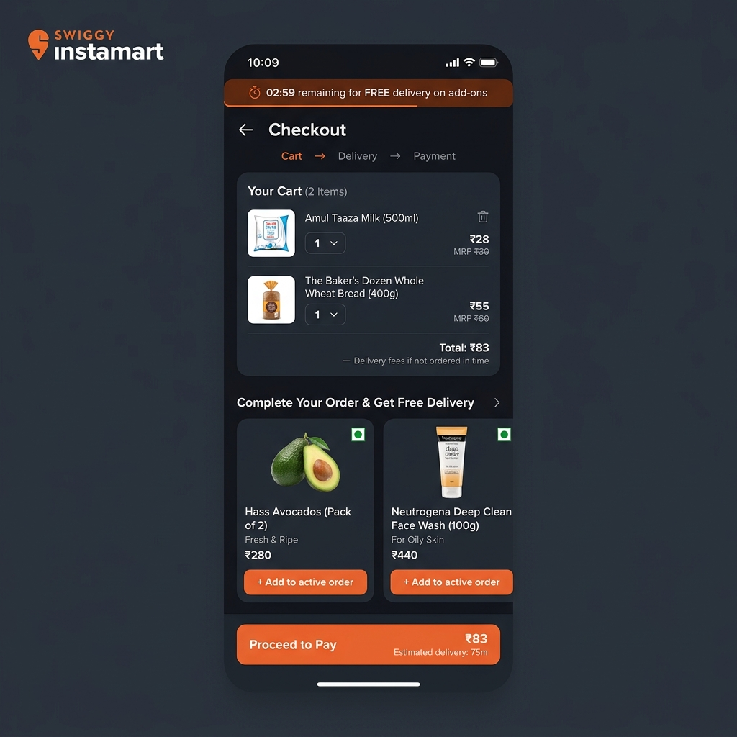
PART 4 · LIVE MVP PLAYGROUND
The Deployed MVP: 3-Minute Post-Checkout Add-On Window
Interactive Deployed Checkout Sandbox
• Checkout Simulator: Placing dairy essentials simulates payment completion and triggers the active 3-minute window.
• Dynamic Countdown Banner: Displays an urgent timer counting down the dark store's packaging cycle.
• Fee-Free Add-on Carousel: Displays organic avocados, dog treats, and face washes with ₹0 delivery fee. Selecting an item dynamically updates checkout totals.
Try the Deployed MVP: https://aashritamalviya1999.github.io/swiggy-instamart-discovery/
Swiggy Instamart Growth Portfolio | AI Product Discovery Engine
Slide 8 of 10

Slide 9
PART 4 · GTM ROLLOUT
Phased Rollout Strategy & Experiment Design
MVP PILOT EXPERIMENT DESIGN
• Target Testing Cohort Split: - Treatment: Post-checkout add-on window with timer & waived delivery fee. - Control: Current standard checkout flow (no window, full fees).
• Experiment Metrics Measured: - Primary: Cross-category purchase rate. - Secondary: Average Order Value (AOV), Customer Retention, Packer/Rider SLA.
• Sample Size Power: Trialed in Bangalore East dark store over 30 days to reach statistical power.
PHASED GTM AND SAFETY GATES
• Phased Rollout stages: - Shadow Mode (Weeks 1-2): Measure baseline cycles. - Buffer Trial (Weeks 3-6): Launch in 1 dark store. - Expansion (Weeks 7-12): Scale to 10 dark stores.
• Operational Lock-out Gates: - Packing status: Disable client UI if packing has started. - Weight Gate: Limit add-ons to items <2kg. - Single-Rider: Append order merges into original package.
Swiggy Instamart Growth Portfolio | AI Product Discovery Engine
Slide 9 of 10

Slide 10
PART 4 · SUCCESS & RISKS
Success Metrics, Formula & GTM Risks
Category | Base | Target 30D | Target 90D | Friction Solved
Gourmet | 4.2% | 12.0% | 18.5% | Delivery Fee
Personal Care | 3.1% | 8.5% | 14.0% | Delivery Fee
Baby Care | 1.8% | 5.0% | 9.5% | Size Charts
Pet Care | 2.5% | 7.0% | 12.0% | 10m Dispatch
Success Metrics & SLA Operational Guardrails
• North Star Metric: Cross-Category Discovery Completion Rate (Target: 35% in 30 days).
• SLA Guardrails (Daily Monitoring): - Customer Retention SLA Delta: Keep >98%. - Delivery SLA Breach Rate: Keep 0% change. - Packing Time Delta: Keep <+15s. - Order Cancellation Rate: Keep <1% change.
• Business Indicators (30-90 Days): - Average Order Value (AOV) Delta: Target +18%. - Revenue Per User / Contribution Margin Delta: Target +12% lift.
SUCCESS FORMULA DEFINITION
Cross-Category Purchase Rate = [Users purchasing ≥1 new category] ÷ [Monthly Active Customers]
Swiggy Instamart Growth Portfolio | AI Product Discovery Engine
Slide 10 of 10

